Slide 1
GASES
Chapter 5

Slide 2
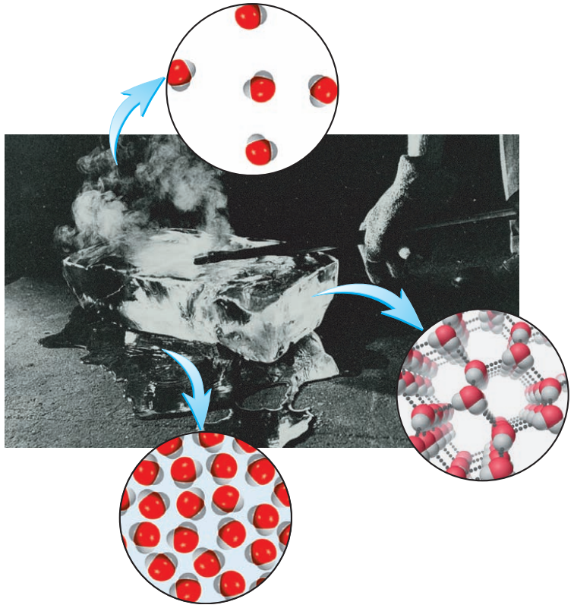
States of Matter
Gas (vapours)
Particles move freely and at random in all the space available.
Collide less often than in liquid.
Solid
Particles only vibrate about fixed positions.
Regular structure.
Liquid
Particles have some freedom and can move around each other.
Collide often.

Slide 3
Properties of Gases

Slide 4
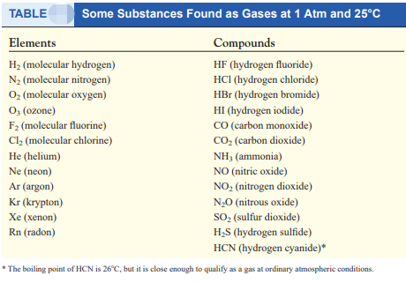
Gaseous substances (at STP)

Slide 5
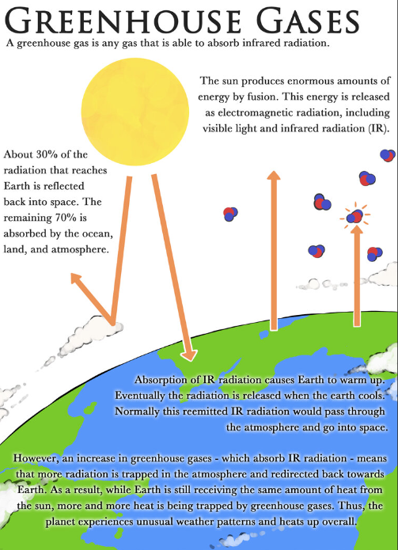
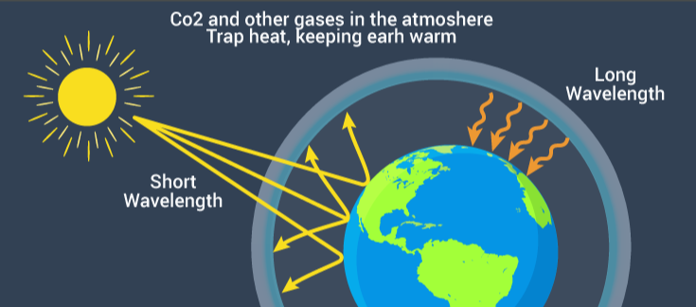

Slide 6
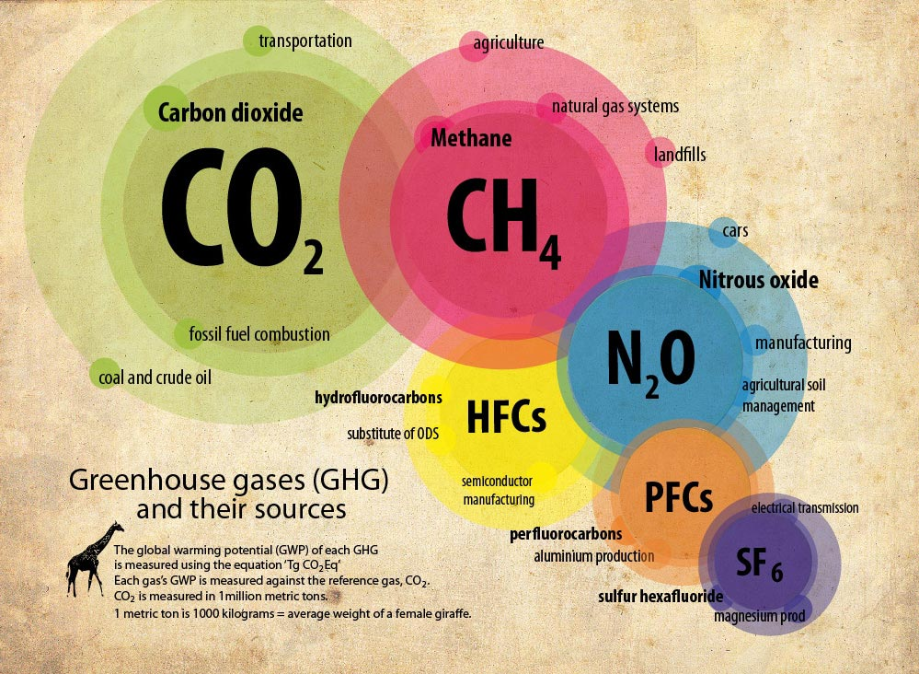
Green house gases (GHGs)

Slide 7
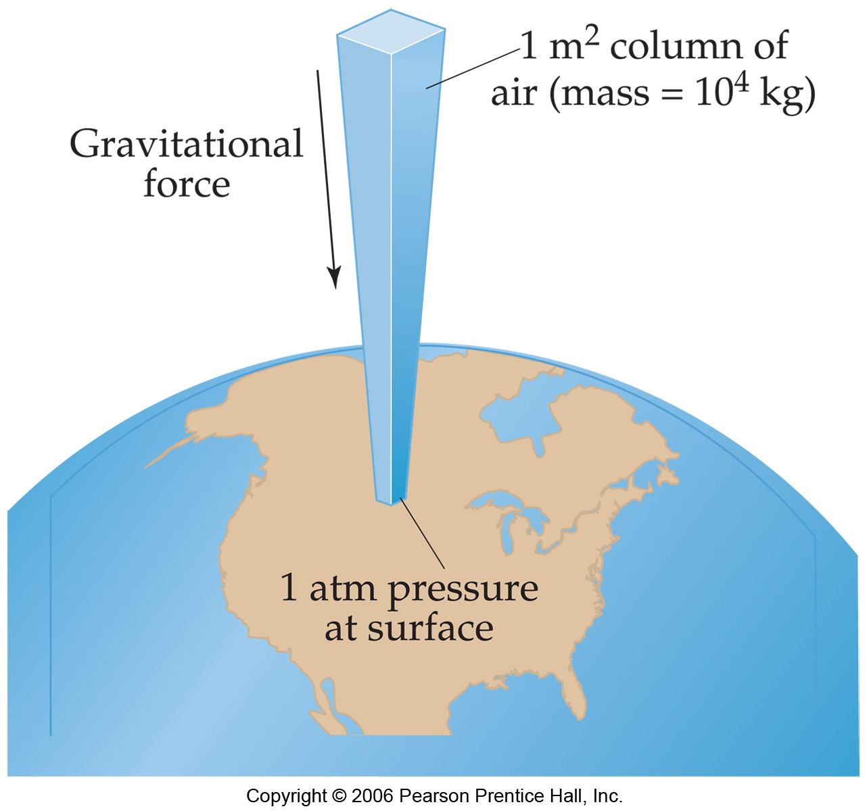
Pressure
Pressure is the amount of force applied to an area.
F
A
P =
Atmospheric pressure is the weight of air per unit of area.

Slide 8
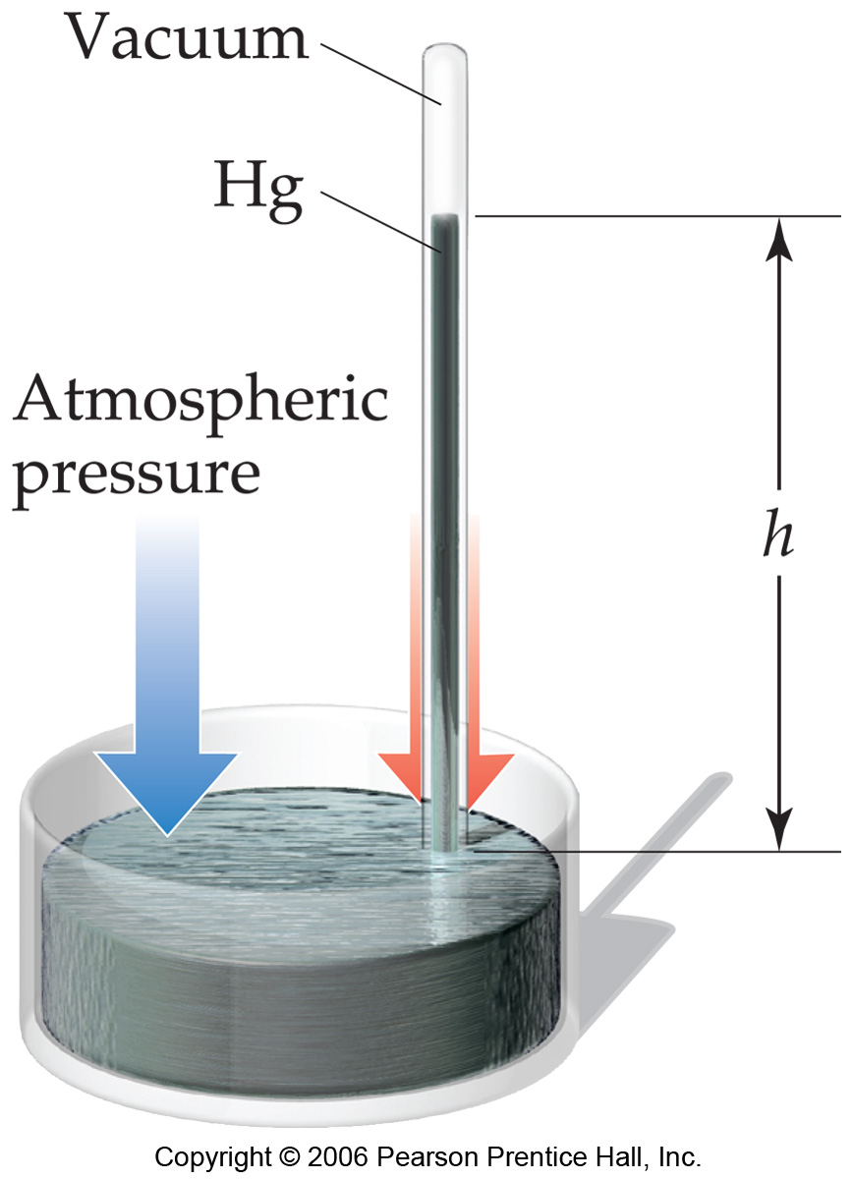
Units of Pressure
Pascals
1 Pa = 1 N/m²
Bar
1 bar = 10⁵ Pa = 100 kPa
Atmosphere
1.00 atm = 760 torr
mm Hg or torr
These units are literally the difference in the heights measured in mm (h) of two connected columns of mercury.

Slide 9
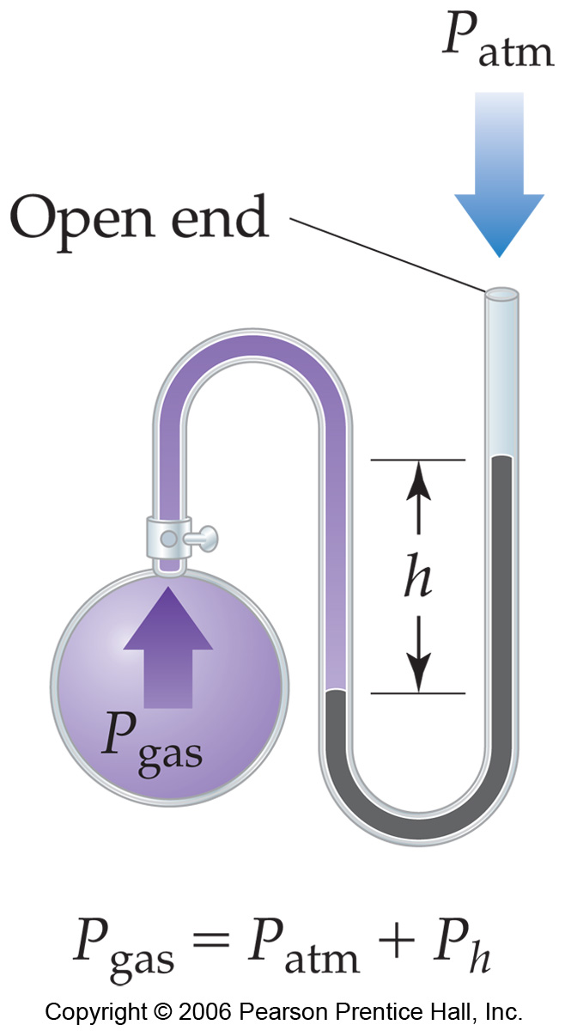

Manometer
Device used for measuring the pressure of a gas in a container.

Slide 10
Standard Pressure
Normal atmospheric pressure at sea level is referred to as standard pressure.
It is equal to
1.00 atm
760 torr (760 mm Hg)
101.325 kPa

Slide 11
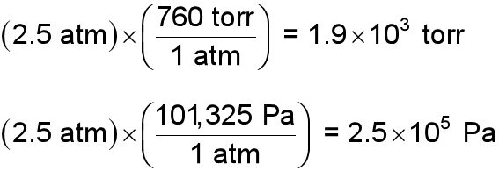
Pressure Conversions: An Example
The pressure of a gas is measured as 2.5 atm. Represent this pressure in both torr and pascals.

Slide 12
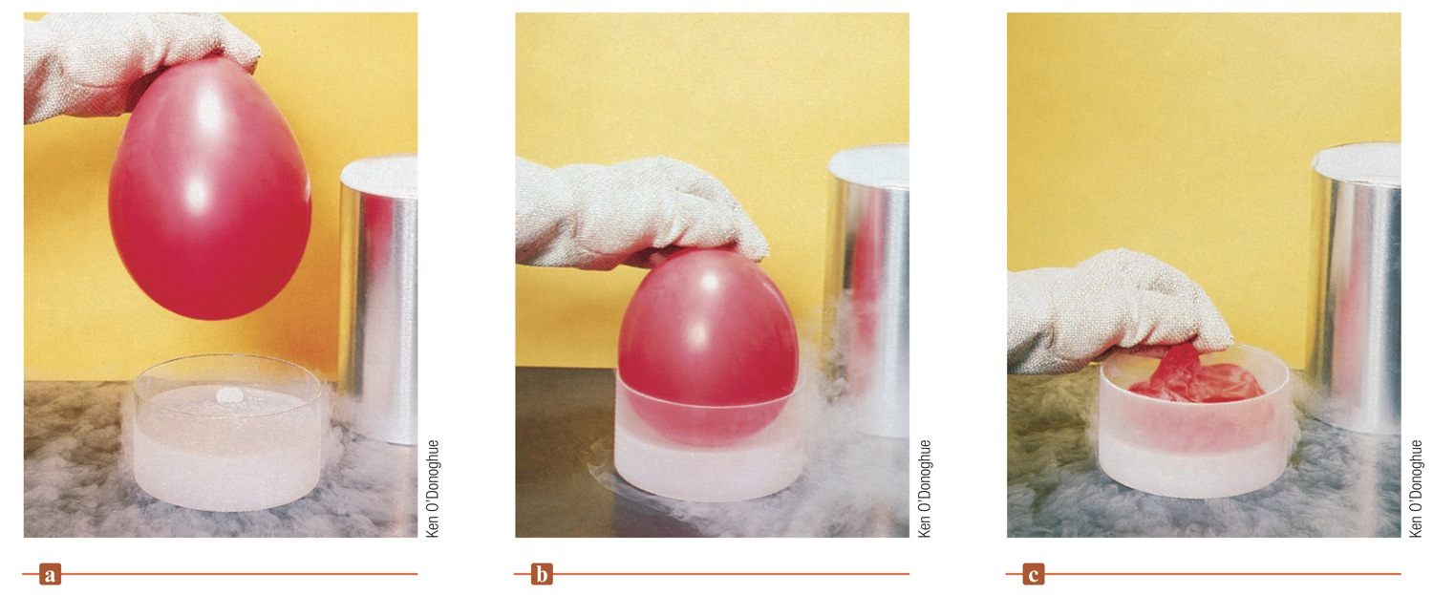
GAS LAWS
Liquid Nitrogen and a Balloon
What happened to the gas in the balloon?
A decrease in temperature was followed by a decrease in the pressure and volume of the gas in the balloon.
Gas laws can be deduced from observations like these.
Mathematical relationships among the properties of a gas (Pressure, Volume, Temperature and Moles) can be discovered.
This is an observation (a fact).
It does NOT explain “why,” but it does tell us “what happened.”

Slide 13
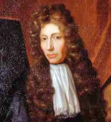
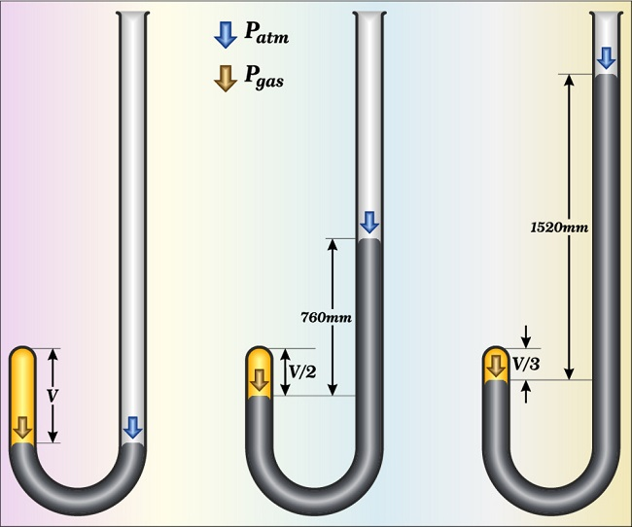
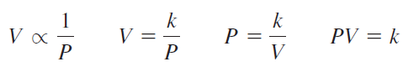
GAS LAWS
Boyle’s Law: Pressure-Volume Relationship
‘The volume of a fixed quantity of gas at constant temperature is inversely proportional to the pressure’.
Pressure and volume are inversely related (constant T, temperature, and n, # of moles of gas).
The mathematical expression showing an inverse relationship between P and V is
where k is a constant called the proportionality constant
This form of Boyle’s law says that the product of the pressure and volume of a gas at constant temperature is a constant

Slide 14
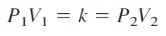
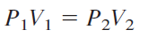
For a given sample of gas PV = k
If we change that sample of gas from one pressure (P1) to another (P2) at constant temperature, the volume will change from V1 to V2.
Both products of P and V must equal the same constant, k:
Because both products are equal to the same constant, they must be equal to each other:

Slide 15
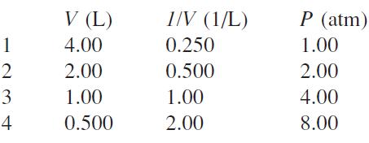
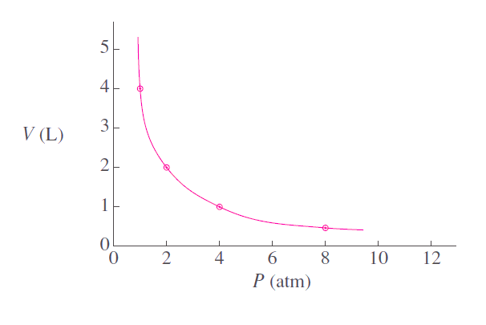
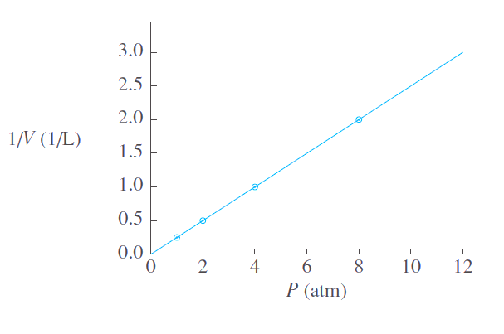
Boyle’s Law (Cont…)
As P and V are inversely proportional
A plot of V versus P results in a curve.
Since
V = k (1/P)
This means a plot of V versus 1/P will be a straight line.
PV = k

Slide 16
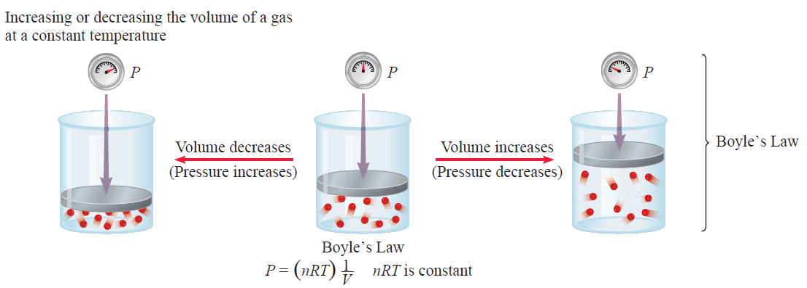
Schematic illustrations of Boyle’s law

Slide 17
EXERCISE!
A 3.50-L sample of gas has a pressure of 0.750 atm. Calculate the volume after its pressure is increased to 1.50 atm at constant temperature.

Slide 18
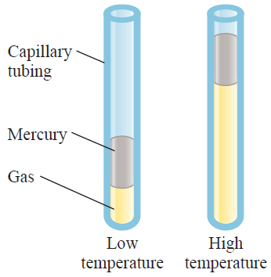
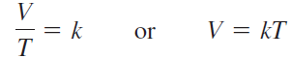
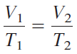
Charles’s Law: Temperature-Volume Relationship
The earliest investigators of this relationship were French scientists, Jacques Charles and Joseph Gay-Lussac.
The volume of a fixed amount of gas at constant pressure is directly proportional to its absolute temperature.
i.e.,
The equation may also be written in terms of two sets of conditions of a given sample of gas at constant pressure:
The pressure exerted on the gas is the sum of the atmospheric pressure and the pressure due to the weight of the mercury.
where V1 and V2 are the volumes of the gas at temperatures T1 and T2 (both in kelvins), respectively

Slide 19
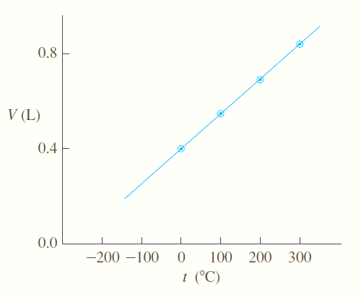
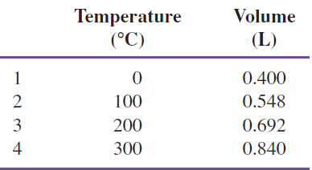
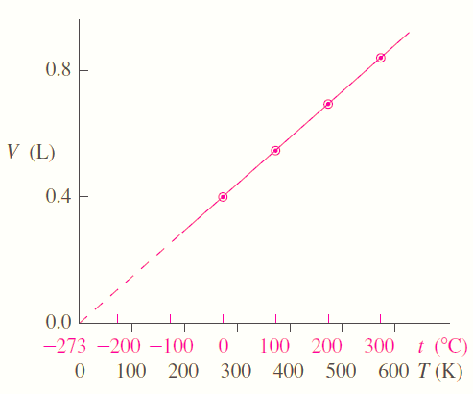
A plot of V versus T will be a straight line.

Slide 20
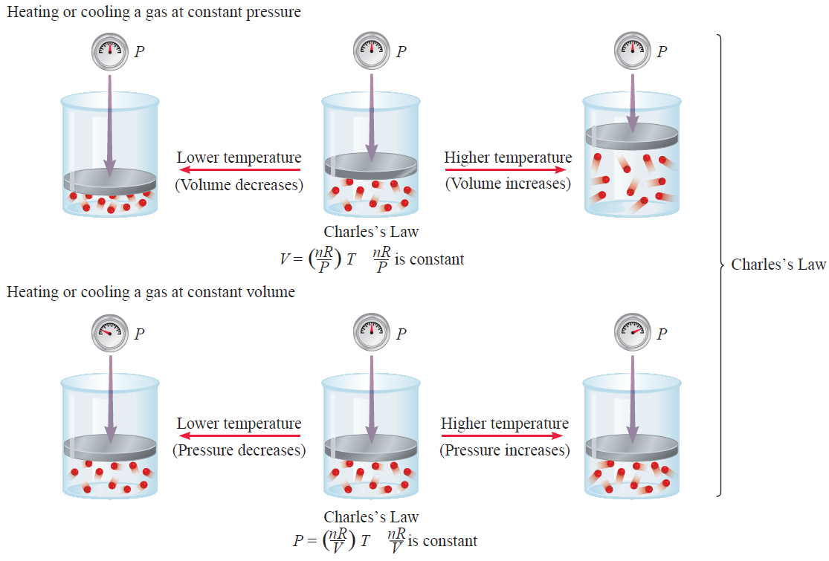

Slide 21
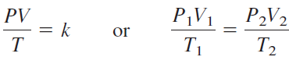
Combined Gas Law
Boyle’s and Charles’ laws may be merged into one law, called the combined gas law, expressed in equation form as follows:
Neither temperature nor pressure is constant

Slide 22
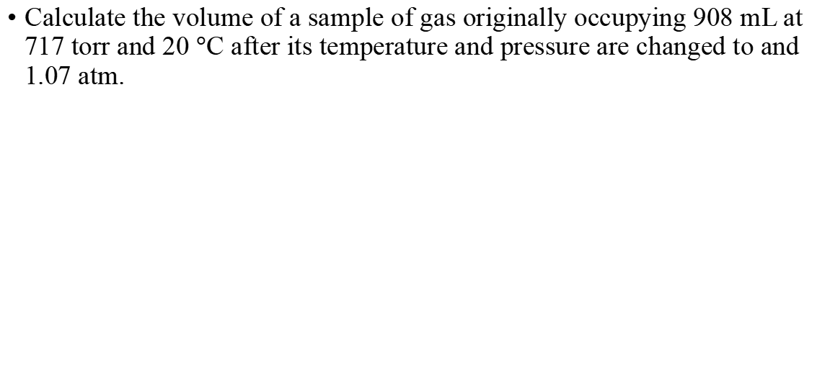
Exercise
Calculate the volume of a sample of gas originally occupying 908 mL at 717 torr and 20 $°$C after its temperature and pressure are changed to and 1.07 atm.

Slide 23
Practice Exercise
Calculate the original volume of a sample of gas that is at 717 torr and before its volume, temperature, and pressure are changed to 908 mL, 72°C, and 1.07 atm.

Slide 24
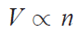
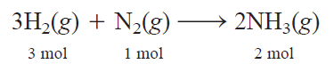
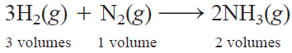
Avogadro’s Law Volume-Amount Relationship
The volume of a gas at constant temperature and pressure is directly proportional to the number of moles of the gas.
Synthesis of ammonia from molecular H₂ and N₂:
V = kn
Because, at the same temperature and pressure, volumes of gases are directly proportional to the number of moles of the gases present, we can write

Slide 25
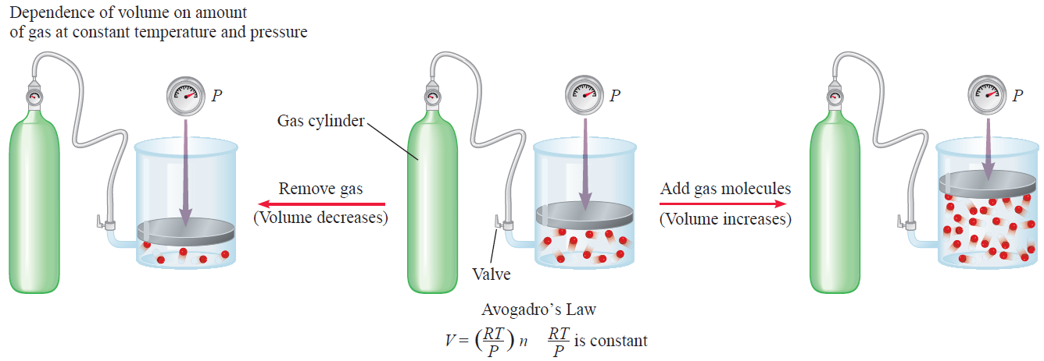
Schematic illustrations of Avogadro’s law

Slide 26
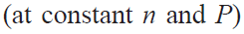
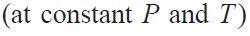
Ideal-Gas Equation
An ideal gas is a hypothetical gas whose pressure-volume temperature behavior can be completely accounted for by the ideal gas equation.
So far we’ve seen that
(at constant n and T )
V ∝ 1/P (Boyle’s law)
V ∝ T (Charles’s law)
V ∝ n (Avogadro’s law)
Combining these, we get
nT
P
V ∝

Slide 27
Ideal-Gas Equation Contd….
The relationship
nT
P
V ∝
then becomes
nT
P
V = R
or
PV = nRT
Ideal gas equation, describes the relationship among the four variables P, V, T, and n.

Slide 28
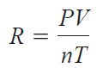
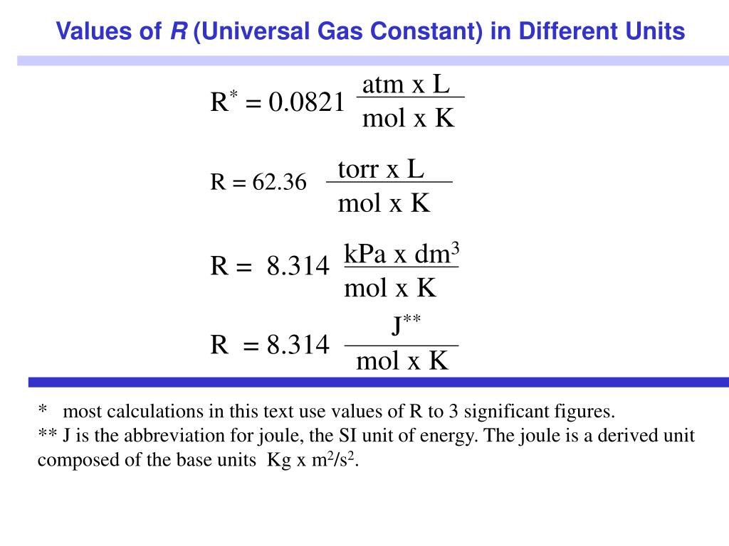
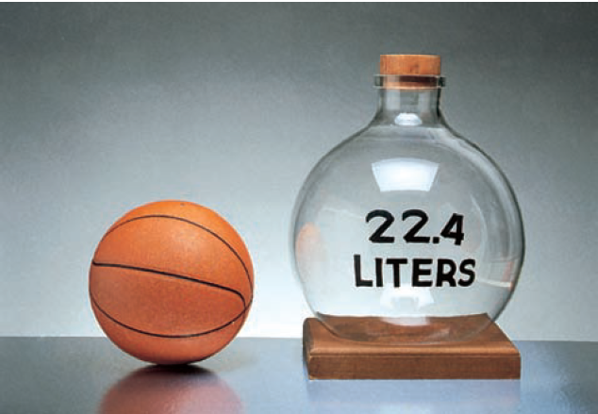
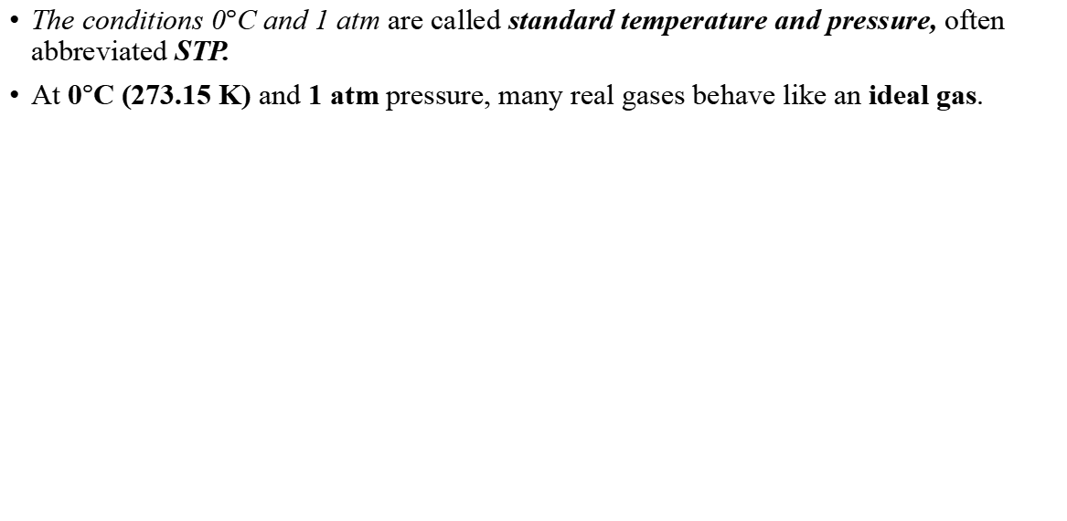
The conditions 0$°$C and 1 atm are called standard temperature and pressure, often abbreviated STP.
At 0$°$C (273.15 K) and 1 atm pressure, many real gases behave like an ideal gas.
A comparison of the molar volume at STP (which is approximately 22.4 L) with a basketball.

Slide 29
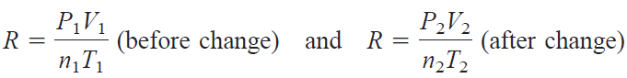
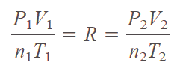
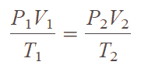
The ideal gas equation is useful for problems that do not involve changes in P,V, T, and n for a gas sample.
When conditions (P,V, T, and n for a gas sample) change, a modified form of the ideal gas equation is employed that takes into account the initial and final conditions.
PV = nRT
If n1 = n2, as is usually the case because the amount of gas normally does not change, the equation becomes

Slide 30
Practice exercise
Calculate the volume (in liters) occupied by 7.40 g of NH₃ at STP.

Slide 31
Practice exercise
Sulfur hexafluoride (SF6) is a colorless, odorless, very unreactive gas. Calculate the pressure (in atm) exerted by 1.82 moles of the gas in a steel vessel of volume 5.43 L at 45C.

Slide 32
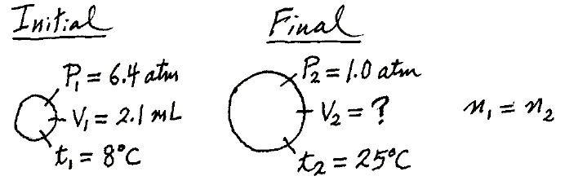
A small bubble rises from the bottom of a lake, where the temperature and pressure are 8C and 6.4 atm, to the water’s surface, where the temperature is 25C and the pressure is 1.0 atm. Calculate the final volume (in mL) of the bubble if its initial volume was 2.1 mL.

Slide 33
A gas initially at 4.0 L, 1.2 atm, and 66C undergoes a change so that its final volume and temperature are 1.7 L and 42C. What is its final pressure? Assume the number of moles remains unchanged.

Slide 34
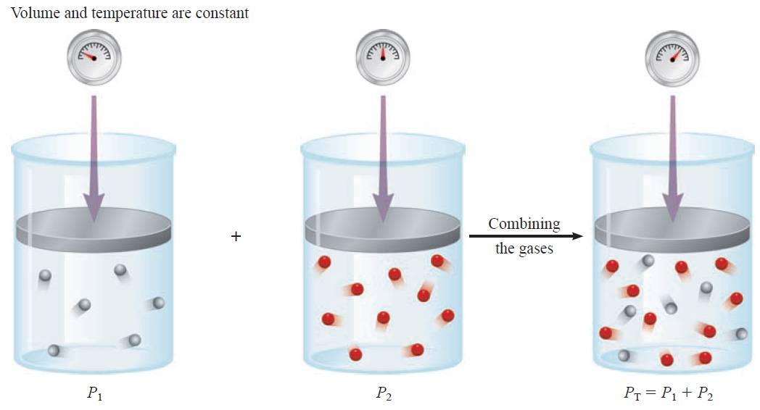
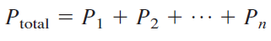
Dalton’s Law of Partial Pressures
In the mixtures of gases, the total gas pressure is related to partial pressures, that is, the pressures of individual gas components in the mixture.
For a mixture of gases in a container,
The total pressure exerted is the sum of the pressures that each gas would exert if it were alone.
In other words,
Schematic illustration of Dalton’s law of partial pressures

Slide 35
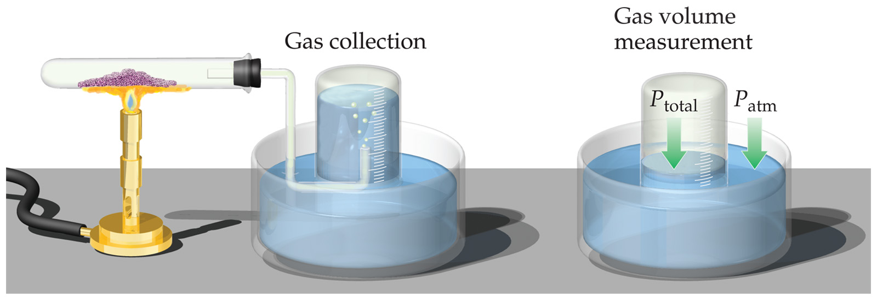
Partial Pressure
When one collects a gas over water, there is water vapor mixed in with the gas.
To find only the pressure of the desired gas, one must subtract the vapor pressure of water from the total pressure.

Slide 36
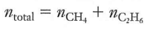
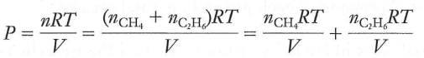
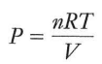
Example, natural gas (composition of methane and ethane)
Assume natural gas, behaves like ideal gas, pressure can be written as follows:
where n, the total number of moles of gases
P is the total pressure as result of the collisions of both types of molecules

Slide 37
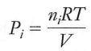
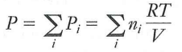




For an arbitrary gas mixture, partial pressure of each component can be written as
i indicates which gas we are talking about
The total pressure of the mixture （P）is the sum of partial pressures:
Total number of moles is the sum of the numbers of moles of the individual components:
Dividing P_{i} by P, we obtain
The mole fraction is always smaller than 1.
We can express partial pressure of component i as
Mole fraction expresses the ratio of the number of moles of one component to the number of moles of all components present.
mole fraction of component i
where ni and nTotal are the number of moles of component i and the total number of moles present, respectively

Slide 38
Practice exercise
A mixture of gases contains 4.46 moles of neon (Ne), 0.74 mole of argon (Ar), and 2.15 moles of xenon (Xe). Calculate the partial pressures of the gases if the total pressure is 2.00 atm at a certain temperature.

Slide 39
Practice exercise
A sample of natural gas contains 8.24 moles of methane (CH₄), 0.421 mole of ethane (C₂H₆), and 0.116 mole of propane (C₃H₈). If the total pressure of the gases is 1.37 atm, what are the partial pressures of the gases?

Slide 40
Gas stoichiometry
Gas stoichiometry is the study of the relative amounts of reactants and products in reactions that involve gases.
Gas stoichiometry is the quantitative relationship between reactants and products in a gas reaction.
Using PV=nRT, gas stoichiometry applies when the gases are ideal, and the temperature, pressure, and volume of the gases are all known.

Slide 41
Molar volume of ideal gas at STP
For 1 mole of an ideal gas at 0°C or 273 K and 1 atm, the molar volume (volume of 1 mol of the gas) at STP is 22.42 L.
PV = nRT

Slide 42
Calculate the volume that 48.3 g of sulfur dioxide gas occupies at STP.

Slide 43


Slide 44
How many liters of oxygen gas at and 1.13 atm can be prepared by thermal decomposition of 0.950 g of KClO₃?

Slide 45


Slide 46

Kinetic Molecular Theory
The gas laws help us to predict the behavior of gases
Boltzmann & Maxwell: physical properties of gases can be explained in terms of the motion of individual molecules.
Gases do not always behave ideally, so the simple gas law calculations may not be an accurate model.
This is a model that aids in our understanding of what happens to gas particles as environmental conditions change.

Slide 47

Kinetic Molecular Theory
Postulates of the Kinetic Molecular Theory
Gases are composed of small molecules that are in constant, random motion.
Molecules travel in straight lines in any arbitrary direction until they hit other molecules or the walls of the container

Slide 48

Postulates of the Kinetic Molecular Theory
2）The particles in a gas are infinitely small; they occupy no volume
3） The particles are assumed to exert no forces on each other; they are assumed neither to attract nor to repel each other.

Slide 49

Postulates of the Kinetic Molecular Theory
4) Molecular collisions are perfectly elastic; that is, no energy is lost when the molecules collide.
The molecules bounce off one another without any loss of total energy.
No friction or energy loss of any kind occurs.

Slide 50


5) The average kinetic energy of molecules is assumed to be directly proportional to the absolute temperature of the gas.
Increasing temperature will increase the sped of the molecules, which causes more collision & gas pressure.
As some molecules move fast and some slow
The peak of each curve represents the Most probable speed
It is the speed of the largest number of molecules
Fig: Distribution of molecular speeds at various temperature

Slide 51

Lighter molecules travel faster than heavier molecules
Fig: Distribution of molecular speeds of four gases at constant temperature (300K)

Slide 52

Maxwell-Boltzman distribution of speed

Slide 53
Non-ideal (Real) Gases
An ideal gas is a hypothetical concept. No gas exactly follows the ideal gas law.
We must correct for non-ideal gas behavior when:
Pressure of the gas is high.
Temperature is low.
Under these conditions:
Concentration of gas particles is high.
Attractive forces become important.

Slide 54

Ideal gas Vs Real gas

Slide 55


Ideal gas Vs Real gas

Slide 56




Deviations from Ideal Behavior
The assumptions made in the kinetic-molecular model (negligible volume of gas molecules themselves, no attractive forces between gas molecules, etc.) break down at high pressure and/or low temperature.

Slide 57
Correcting the Ideal Gas equation
The ideal-gas equation can be adjusted to take these deviations from ideal behavior into account.
The corrected ideal-gas equation is known as the van der Waals equation.
PV = nRT
Ideal gas equation
corrected pressure
corrected volume
P_{ideal}
V_{ideal}
a and b are van der Waals constants

Slide 58

Non-ideal gas behavior is described by the
van der Waals equation
a = gas constant describing the strength of the attractions
b = gas constant describing the size of the gas particles
Polar
Non-polar
Strong interaction
Weak interaction

Slide 59

Values of the van der Waals Constants for Some Gases
The value of a reflects how much of a correction must be made to adjust the observed pressure up to the expected ideal pressure.
A low value for a reflects weak intermolecular forces among the gas molecules.

Slide 60
Practice exercise
Use the ideal gas law and van der Waals equation to calculate the pressure exerted by a 4.25 L gas container containing 3.46 mol of CO₂ at a temperature of 229 C. [a = 3.59 atm. L²/mol² and b = 0.0427 L/mol)
PV = nRT
P_{ideal} = nRT/V
P = (3.46 mol) (0.0821 L. atm/mol. K) (502 K) / 4.25 L
P_{ideal} = 33.5 atm
P_{real} + a(n/V)² (V – nb) = nRT
P = nRT/ (V- nb) – a(n/V)²
P = (3.46 mol) (0.0821 L. atm/mol. K) (502 K) / 4.25 L – (3.46 mol) (0.0427 L/mol) – (3.59 L. atm/mol. K) (3.46 mol)² / (4.25 L)²
P_{real} = 32.4 atm
Ideal Gas Law: van der Waals equation:
P_{ideal} = 33.5 atm P_{real} = 32.4 atm
(Good estimate) (more accurate)
Much higher pressures would cause deviation

Slide 61
Practice exercise
Calculate the pressure exerted by 1.0 mol of Cl₂ gas in a 5.0 L container at a temperature of 200 K, using
a) The ideal gas law
b) Van der Waals equation (a=6.49 atm. L²/mol², and b = 0.0562 L/mol)

Slide 62

Practice exercise
Calculate the pressure exerted by 0.3 mol of acetic acid in a 5.0 L container at a temperature of 40 $℃$, using
a) The ideal gas law
b) Van der Waals equation (a=17.71 atm. L²/mol², and b = 0.0237 L/mol)

Slide 63

Diffusion and effusion
Diffusion – the mixing of gases.
Effusion – describes the passage of a gas through a tiny orifice into an evacuated chamber.
Rate of effusion measures the speed at which the gas is transferred into the chamber.

